Slide 1


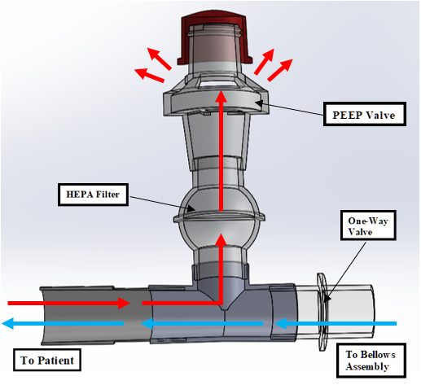
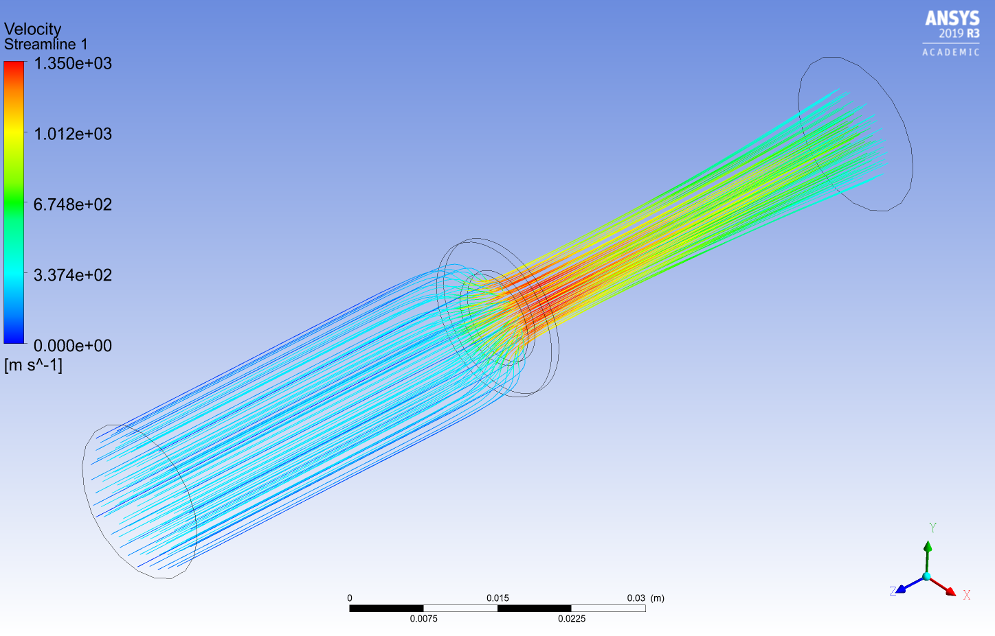
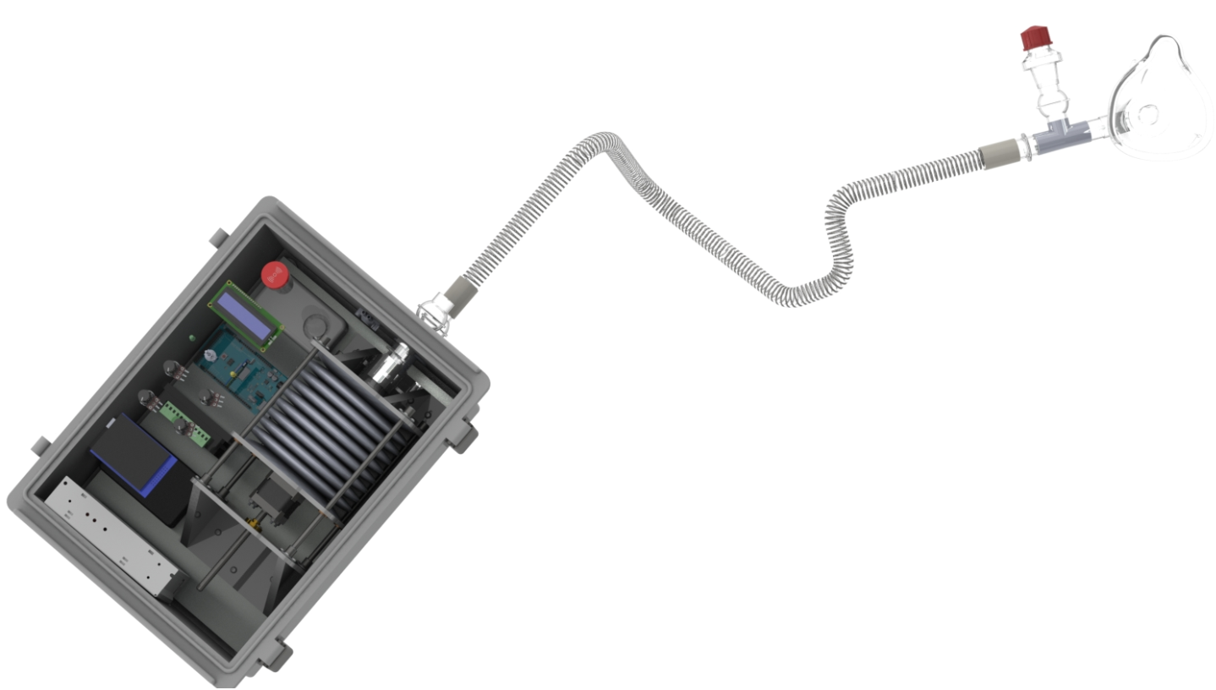
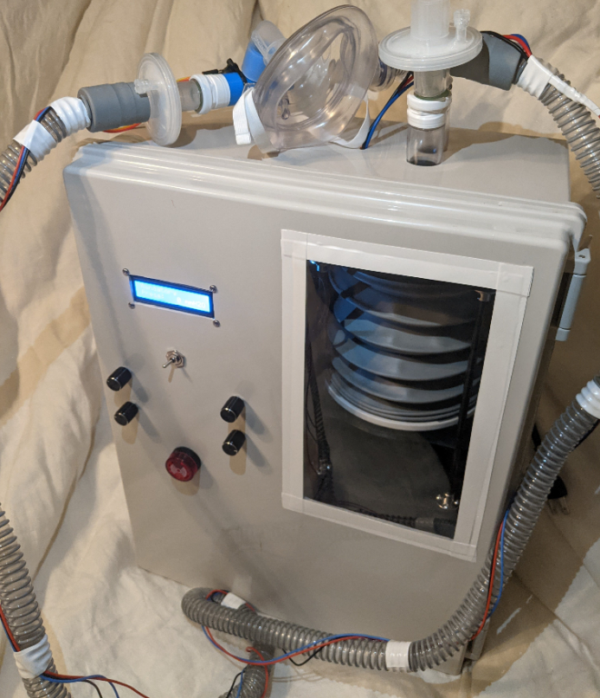

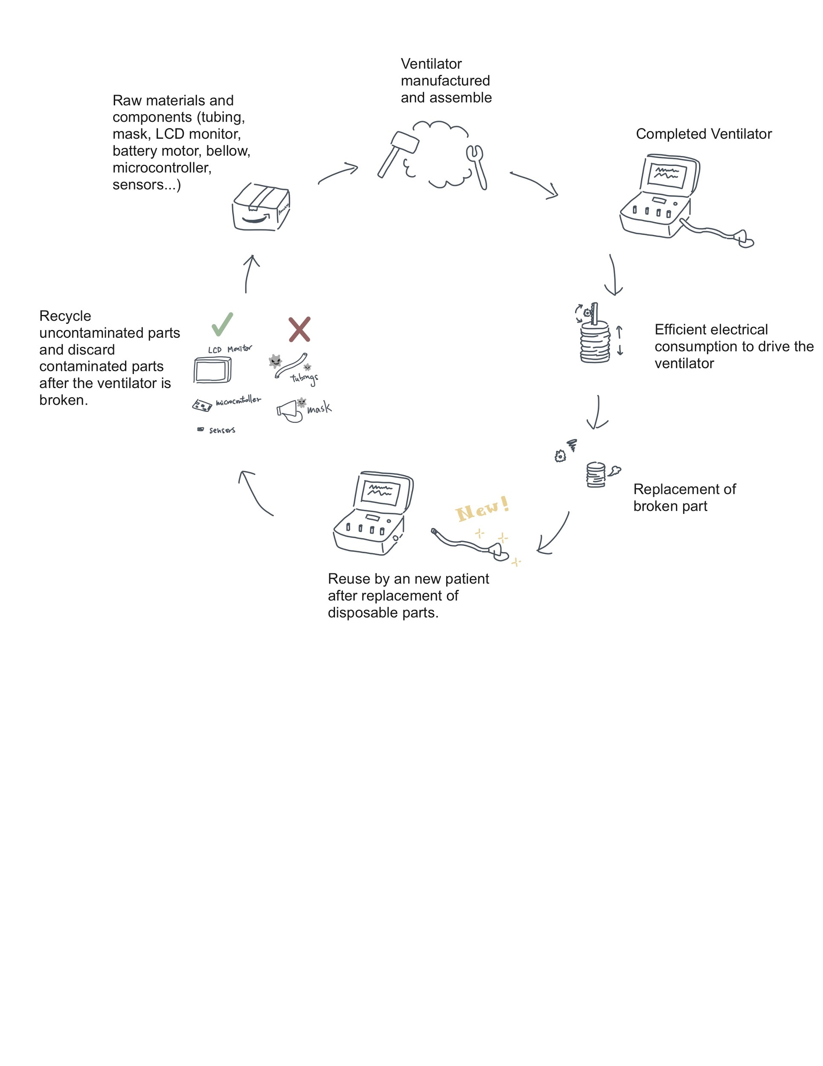
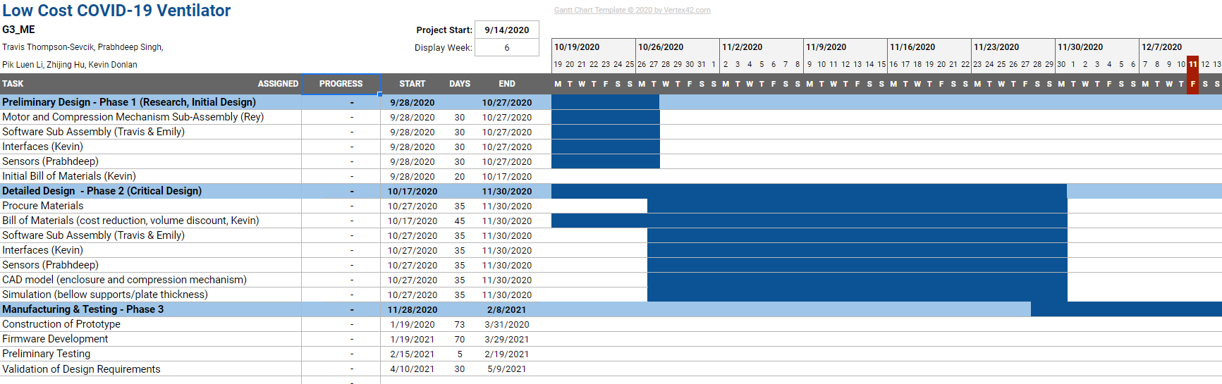
Low Cost Ventilators for COVID-19 Patients
Group G3: Kevin Donlan, Travis Thompson-Sevcik, Zhijing Hu, Pik Luen Li, Prabhdeep Singh Advisor: Prof. Yuebin Guo
Rutgers Univerisity - New Brunswick, School of Engineering
Problem Identification
Low-Cost COVID-19 Ventilator Design and Features
Flow Meter Simulation
The COVID-19 pandemic has identified major deficiencies in the readiness and supply of assistive breathing equipment for patients suffering from respiratory distress. While hospitals have an adequate supply of ventilators to use in normal day to day operations. It was demonstrated that the American healthcare system does not have the means to withstand another pandemic unless a solution is made available to these institutions. Current solutions are limited in scope and applicability. The goal of this project is to fill the gap between emergency use ventilators and long-term assistive breathing devices.
Operational Breakdown
1- Physician Sets Parameters for Patient
2- Bellow Compresses w/ Control Parameters
PEEP Valve
3- Inspiratory Air Flows Through Tubing
One-way Valve
HEPA Filter
4- Expiratory Air Flows Out of PEEP Valve
To measure the flow rate out of the bellow pump, a flow meter was designed. Prior to fabrication, a simulation was performed using ANSYS to determine the appropriate orifice diameter. The following parameters were obtained:
Flow Rate: 6-9 LPM
Beta Ratio: 0.3
Orifice Diameter: 5.65 mm
Repeat 2-4
Design Requirements
Inspiratory
Expiratory
LEGEND
The following design criteria and requirements were set forth for the design of the project:
Cost < $650
Use Off-The-Shelf Components
Must provide sufficient air flow to patient
High degree of portability
Automatic Transition from Assistive to Mandatory Ventilation
Conform to appropriate standards
(1) Bellows Pump
(2) Flow Meter
(3) Battery Pack
(4) User Interface
(5) LCD Display
(6) PEEP Valve Assembly
(7) Extension Hose
(8) Mask
(9) Inlet w/ Filter & Check Valve
DISPOSABLE ASSEMBLY
6
Results & Conclusions
REUSABLE ASSEMBLY
3
To Patient
The final assembly of the Low Cost Ventillator for COVID-19 Patients can be seen in the image below.
7
8
4
9
5
Cost Analysis
2
Project Lifecycle
Reusable Assembly | $500.46
Disposable Assembly | $82.68
Total Cost | $583.14
1
Project Management

